Slide 1







Analysis of Technology Trends
Devesh Sharma
30-Dec-2022

Slide 2



OUTLINE
Executive Summary
Introduction
Methodology
Results
Visualization – Charts
Dashboard
Discussion
Findings & Implications
Conclusion
Appendix

Slide 3

EXECUTIVE SUMMARY
Current technology usage and trend (programming languages , databases and web frames)
Future technology trends
Demographic survey and gender gaps in jobs

Slide 4

INTRODUCTION
Analyzing the developer survey conducted by Stack Overflow in 2019 on
Programming languages
Databases
Demographics
Purpose:
What are the technologies that are demand?
What are the skills and technologies will be in demand?
How demographics and age plays role?
Audience:
IT Professionals
Students and HR

Slide 5

METHODOLOGY
Data Sources:
Stack Overflow Developers Survey 2019
Programming Language Annual Salary
Data Exploration and Cleaning:
Using Python
Data Visualization:
IBM Cognos Analytics
Presentation

Slide 6
RESULTS
Python, the fastest-growing major programming language, has risen in the ranks of programming languages in our survey yet again, edging out Java this year and standing as the second most loved language (behind Rust).
JavaScript and HTML/CSS are the programming languages which are used most at present and will be used in the future.
MySQL is currently the most used database and PostgreSQL will be most used according to the survey while MongoDB will see the most growth in the number of users.
jQuery is the most used Web Frame in the present time but the future lies with React.js

Slide 7
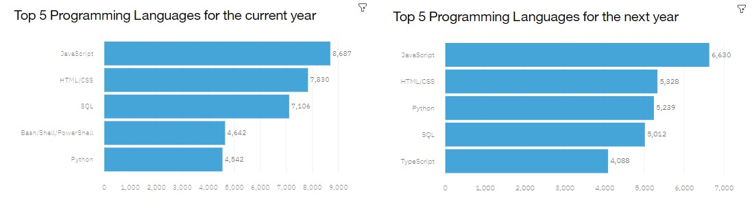
PROGRAMMING LANGUAGE TRENDS
Current Year
Next Year

Slide 8
PROGRAMMING LANGUAGE TRENDS - FINDINGS & IMPLICATIONS
Findings
JavaScript is the most in demand
programming language.
Python, HTML/CSS, and SQL are
other in demand programming
languages.
Skills in TypeScript is more desirable
than Bash/Shell/PowerShell for next
year.
Implications
Python’s increase in demand may
overtake JavaScript in the future.
JavaScript, Python, HTML/CSS, and
SQL are consistently in demand.
Web development remains in high
demand.

Slide 9
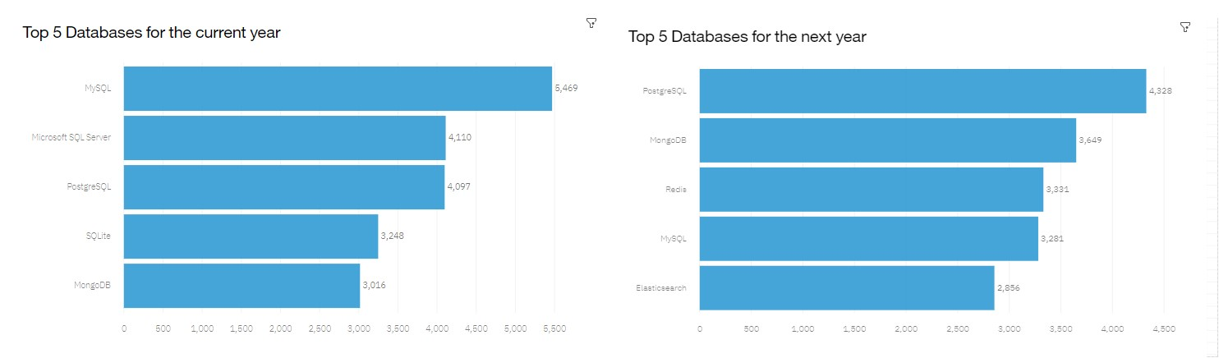
DATABASE TRENDS
Current Year
Next Year

Slide 10
DATABASE TRENDS - FINDINGS & IMPLICATIONS
Findings
MySQL is high in demand at present but it will decrease.
PostgreSQL and MongoDB have an increase in demand.
ElasticSearch is the new comer.
Implications
Demand is high for open-sourced databases.
PostgreSQL and MongoDB are the most consistent in demand databases.
NoSQL databases are gaining more popularity.

Slide 11

DASHBOARD
current technology usage
future technology trend
demographics

Slide 12
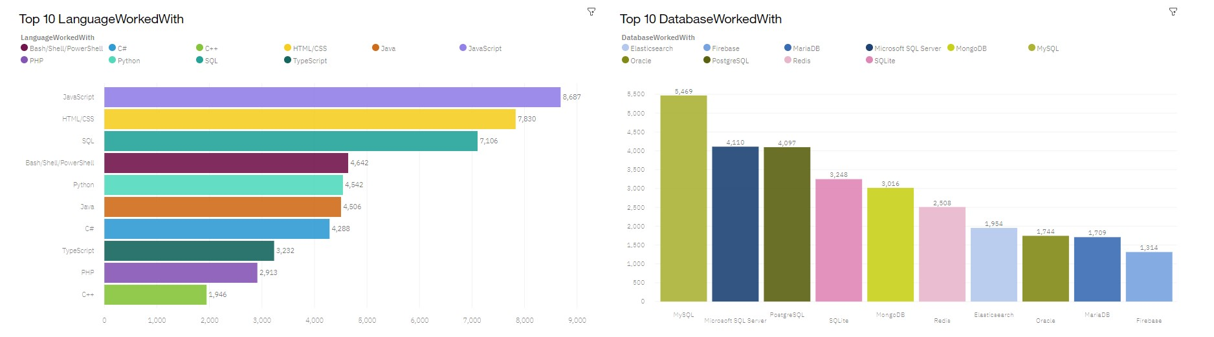
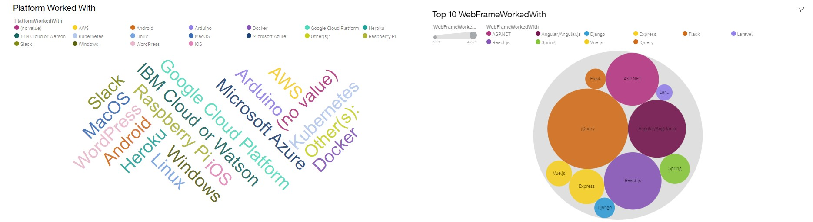
DASHBOARD TAB 1

Slide 13
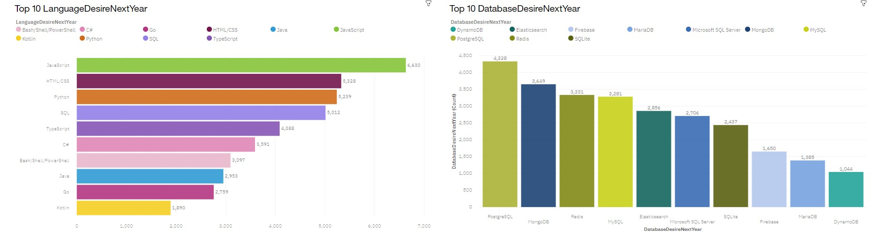
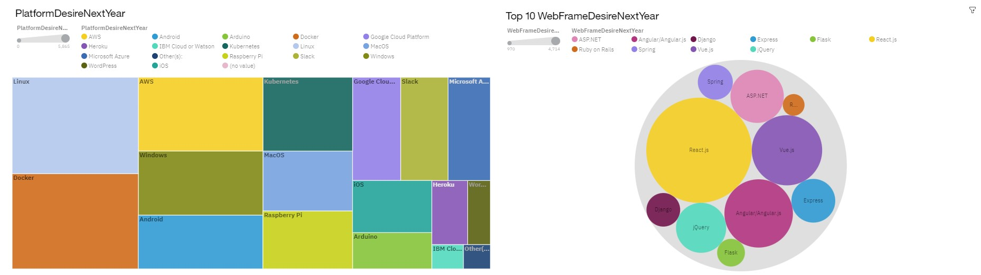
DASHBOARD TAB 2

Slide 14
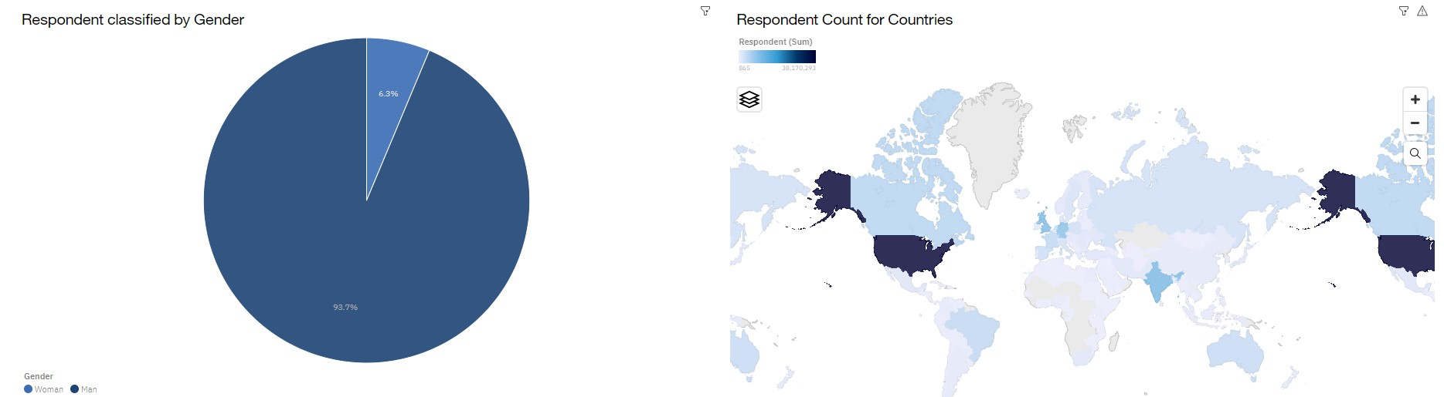
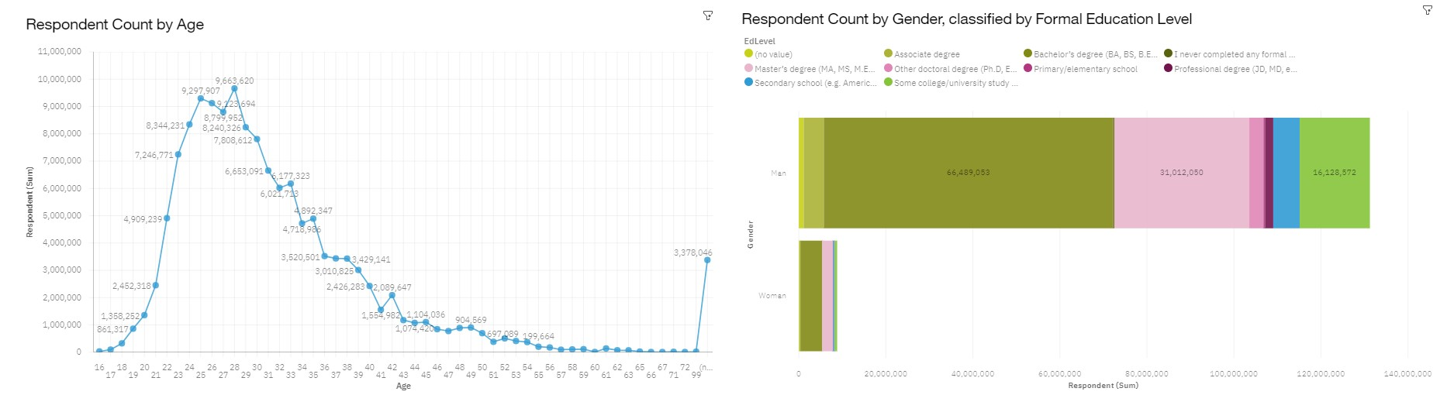
DASHBOARD TAB 3

Slide 15
DISCUSSION
Which technologies should educators place more emphasis on teaching in upcoming years?
Which technologies should prospective developers and data professionals be learning?
What is the developer demographic like? Is there a gender representation gap?

Slide 16
OVERALL FINDINGS & IMPLICATIONS
Findings
High usage and interest in Javascript and HTML/CSS will also remain high. There’s also increasing interest in Typescript.
Increasing interest in Python.
MySQL is high in demand currently ,but in future PostgreSQL and MongoDB have a increasing demand.
React.js demand will keep on increasing.
A significant difference based on gender and age.
Implications
Web development is still in high demand. Current and prospective developers may consider picking up Typescript in addition to Javascript and HTML/CSS.
With growing need to handle big data and perform task related to AI & ML , be equipped with in demand skill set NoSQL and Python.
Companies and IT Professionals should keep on evolving with new technology trends.
Educators and organizations should try to minimize the gender gap.

Slide 17

CONCLUSION
Technology is evolving very quickly.
The findings yielded numerous insights into the technologies most used and desired by developers in addition to the developer demographic.
Insights to current and growing technology which will help the aspiring developers.
Educators in the field, and policy makers aiming to address gender.

Slide 18
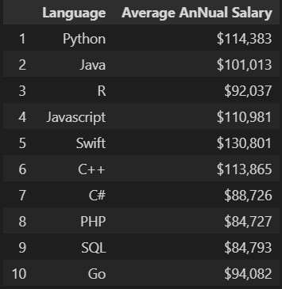

APPENDIX

Slide 19
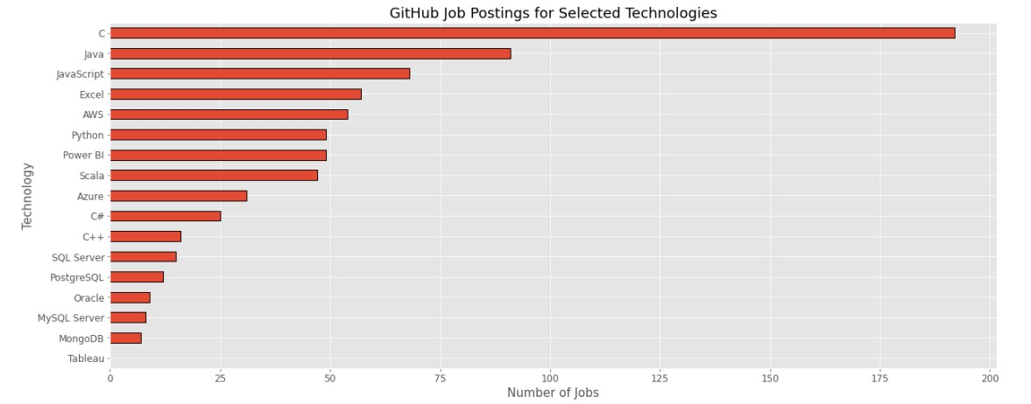
JOB POSTINGS

Slide 20
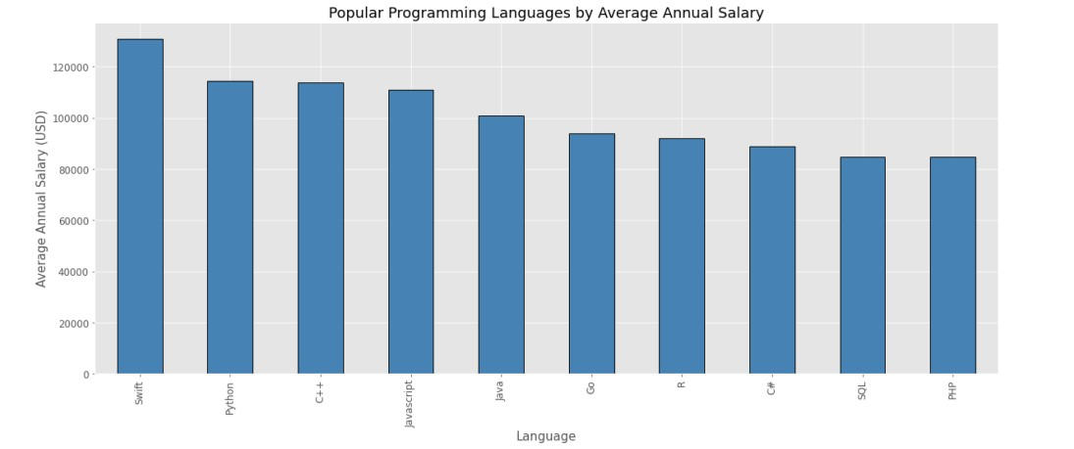
POPULAR LANGUAGES

